Slide 1
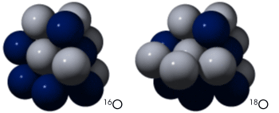
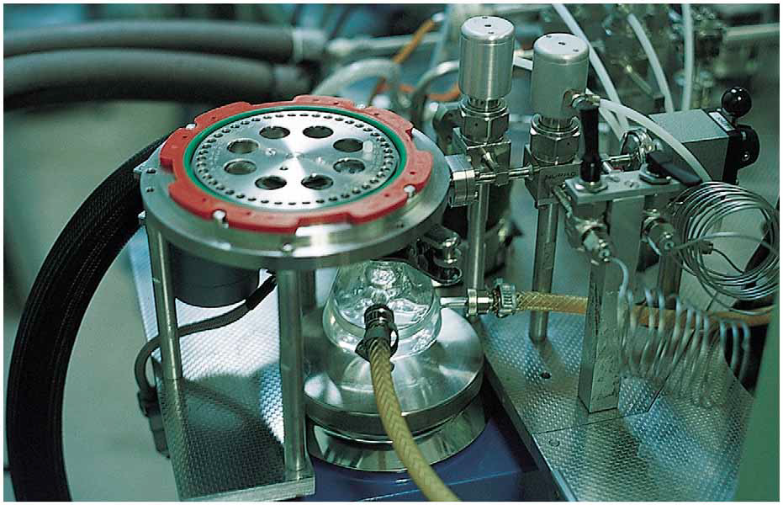
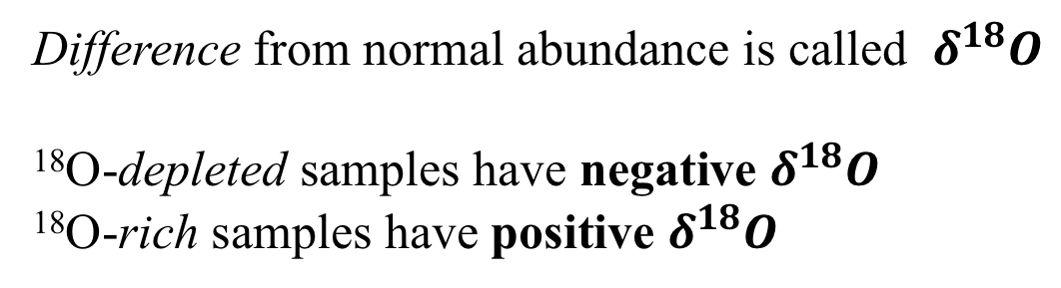
Mass spectrometers measure isotope composition very precisely
Mass spectrometer
Normal abundance is ~99.8%
Normal abundance is ~0.2%
Difference from normal abundance is called $δ^{18}O$
¹⁸O-depleted samples have negative $δ^{18}O$
¹⁸O-rich samples have positive $δ^{18}O$

Slide 2
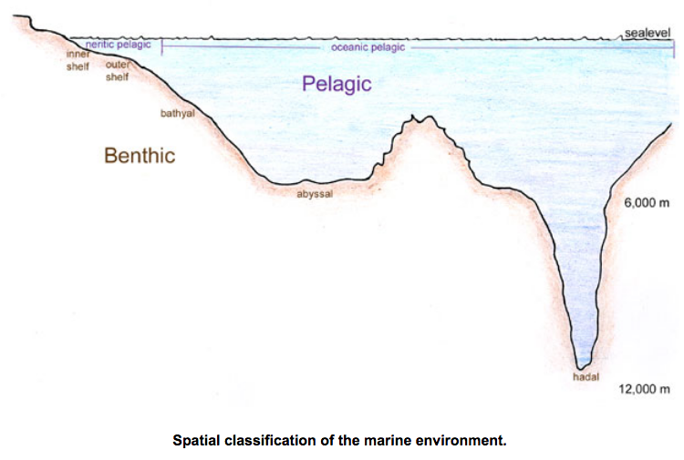
$δ^{18}O$ of water in the oceans
Water vapor in air above the oceans is a little ¹⁸O-depleted compared to normal
Water left behind in the oceans is a little ¹⁸O-rich compared to normal
Can you guess why?
Think about throwing a heavy ball into the air vs a light ball …

Slide 3
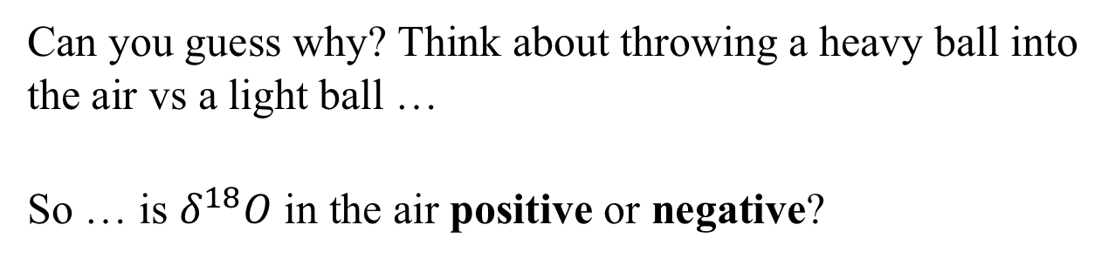
$δ^{18}O$ of water in the air and in the oceans
Water vapor in air above the oceans is a little ¹⁸O-depleted compared to normal
Water left behind in the oceans is a little ¹⁸O-rich compared to normal
Can you guess why? Think about throwing a heavy ball into the air vs a light ball …
So … is $δ^{18}O$ in the air positive or negative?

Slide 4
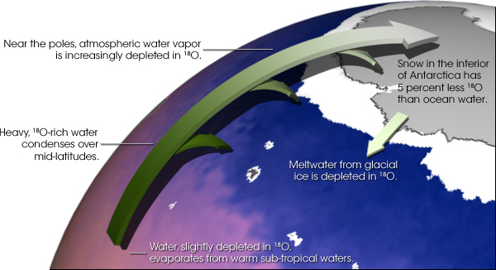
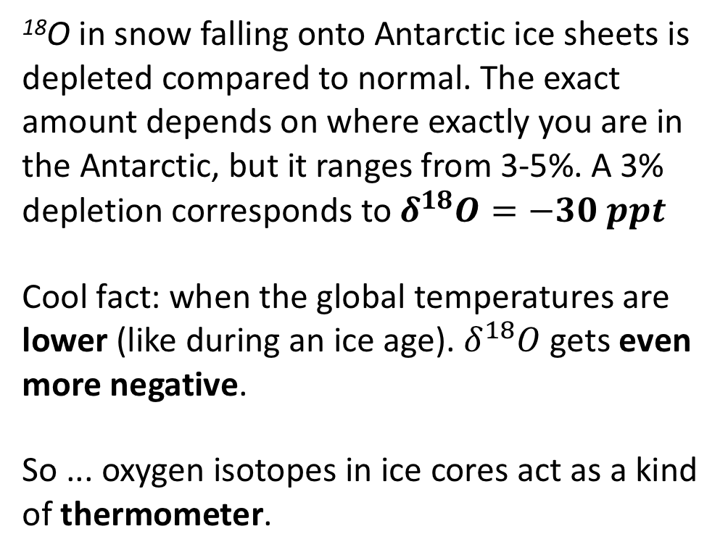
$18O$–depleted water in the air eventually falls as snow
¹⁸O in snow falling onto Antarctic ice sheets is depleted compared to normal. The exact amount depends on where exactly you are in the Antarctic, but it ranges from 3-5%. A 3% depletion corresponds to $δ^{18}O=−30 ppt$
Cool fact: when the global temperatures are lower (like during an ice age). $δ^{18}O$ gets even more negative.
So ... oxygen isotopes in ice cores act as a kind of thermometer.

Slide 5
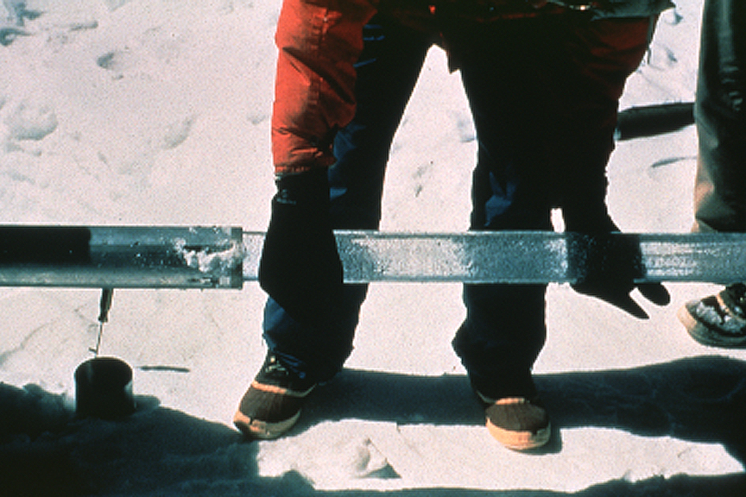
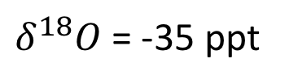
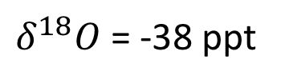
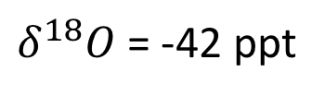
$δ^{18}O$ as a thermometer of past climates
Surface
$δ^{18}O$ = -35 ppt
1000 meters deep
$δ^{18}O$ = -42 ppt
2000 meters deep
$δ^{18}O$ = -38 ppt
Which is the oldest sample?
At which time (depth) was the climate coldest?

Slide 6
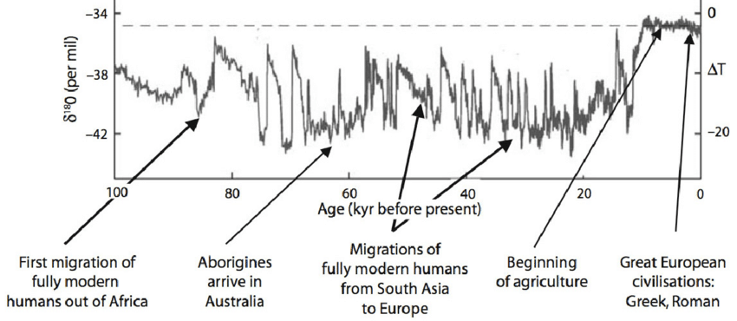
$δ^{18}O$over the last 100 kyr
T
1 kyr = 1000 years
Can you identify important human events around these times?
Notes:
https://www.researchgate.net/publication/280316525_Chapter_20_Extreme_weather_and_resilience_of_the_global_food_system/figures?lo=1

Slide 7
Climate and humans over the last 100 kyr
Migrations and climate change
See also https://www.nature.com/articles/nature19365#s1
Notes:
https://www.researchgate.net/publication/280316525_Chapter_20_Extreme_weather_and_resilience_of_the_global_food_system/figures?lo=1

Slide 8
Dansgaard-Oeschner (“DO”) cycles
Increases in temperature sometimes happened pretty quickly … at the start of DO cycles
Notes:
https://www.researchgate.net/publication/280316525_Chapter_20_Extreme_weather_and_resilience_of_the_global_food_system/figures?lo=1

Slide 9
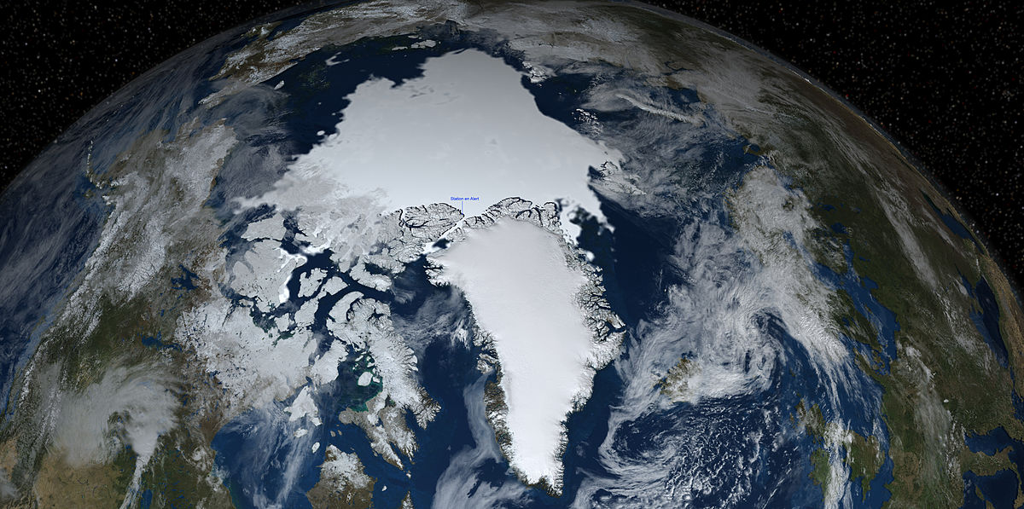
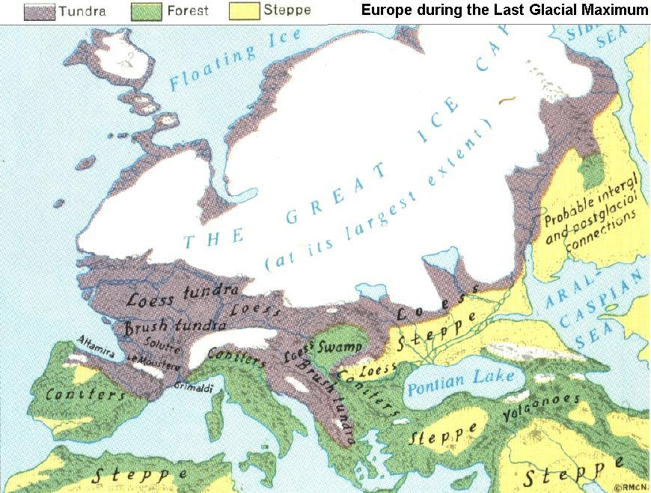
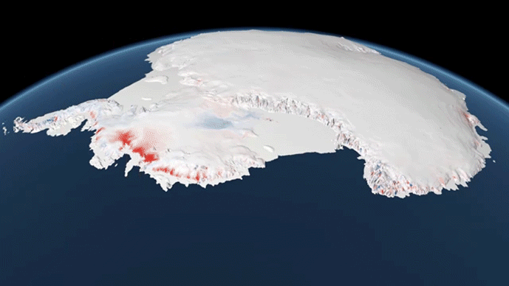
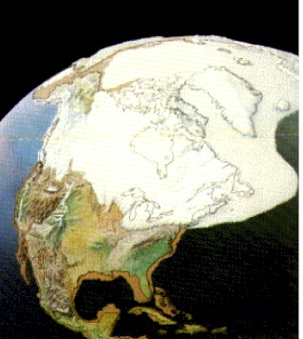
The “Last Glacial Maximum” Great ice sheets of 20,000 years ago
Greenland
Eurasian
Antarctic
North American
Cordilleran
Laurentide

Slide 10
Lots of melting in the last 20,000 years
Greenland
Eurasian
Antarctic
North American
Cordilleran
Laurentide

Slide 11
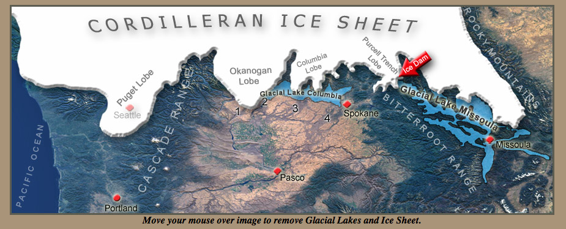
Locally … proglacial lakes and outburst floods
The ice dam and Glacial Lake Missoula, ~15 kyr

Slide 12
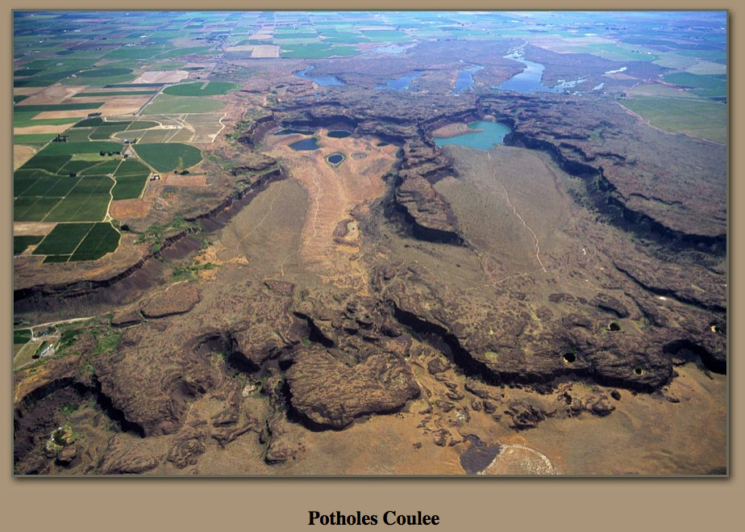
Lake Missoula burst through its ice dam every ~50 years
Potholes Coulee, eastern Washington
Called ”The Scablands” because of flood damage

Slide 13
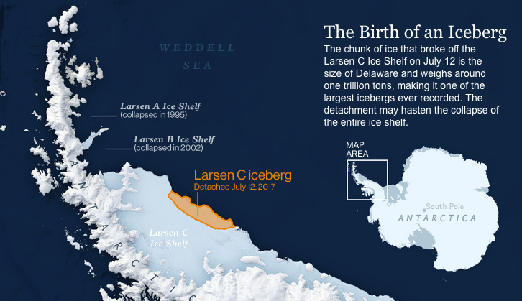
How fast can ice sheets “melt”? Not just melting

Slide 14
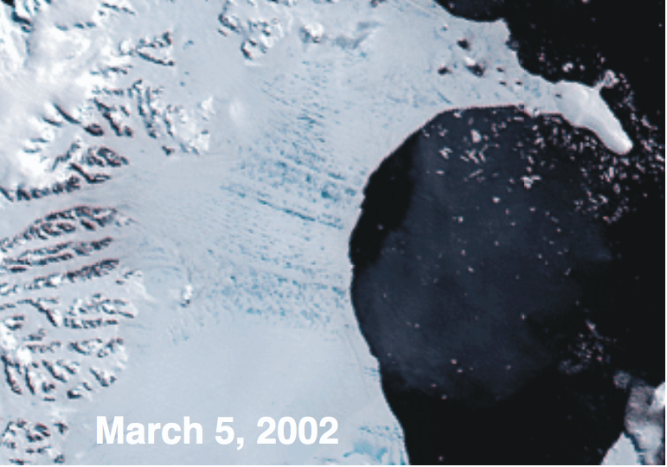
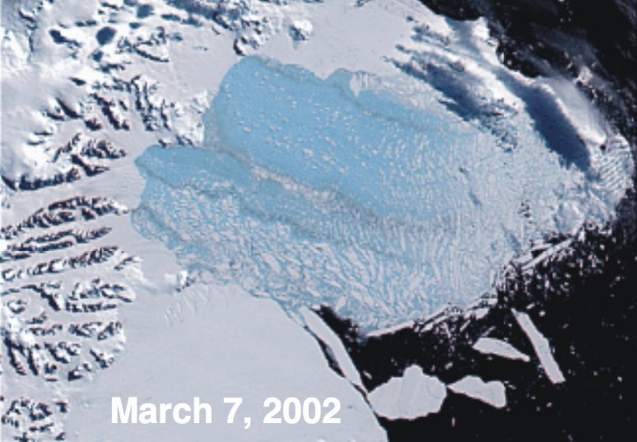
Larsen B over two days in March, 2002
The “explosive” disintegration of Larsen B

Slide 15
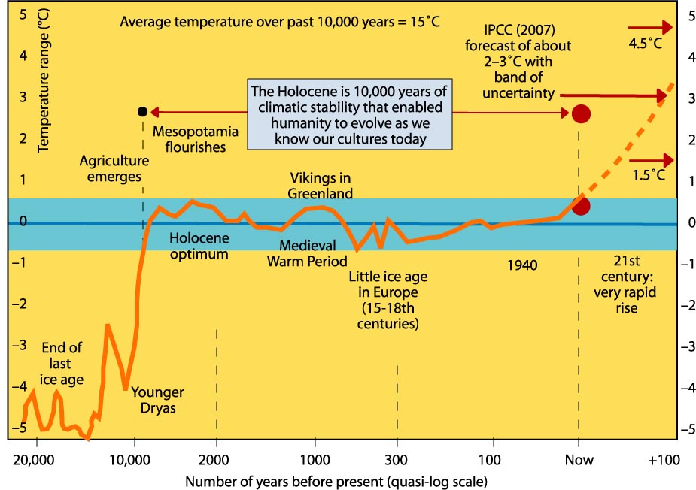
Climate has remained pretty steady in the last 10,000 years
Notes:
http://www.climatecodered.org/2011/01/rethinking-safe-climate-have-we-already.html

Slide 16
What caused all these changes?
Partial answer: Orbital variations changed the amount of sunlight to land on the earth
Notes:
https://www.researchgate.net/publication/280316525_Chapter_20_Extreme_weather_and_resilience_of_the_global_food_system/figures?lo=1

Slide 17
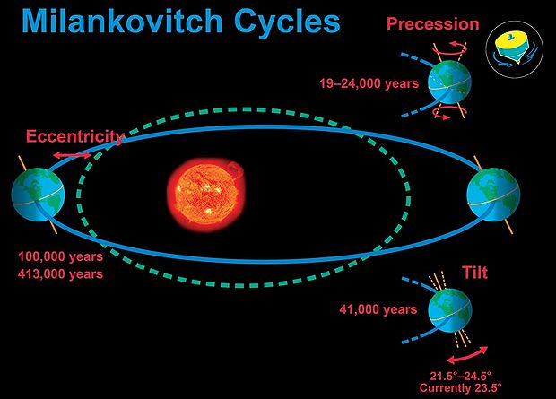
Milankovitch cycles
Milankovitch cycles change how much sunlight reaches the earth, hence can drive glaciation/deglaciation cycles.
DO events occur on a smaller time scale (a few thousand years), so we can’t attribute them to Milankovitch. But we can see Milankovitch fingerprints on longer time scales in the ice core data.
The catch: Milankovitch-related changes in solar energy weren’t big enough on their own … they needed some kind of climate amplifier (like CO₂)
https://www.universetoday.com/39012/milankovitch-cycle/

Slide 18
What we learned
Isotopes of oxygen in ice cores are a temperature proxy (record).
Significant human migrations resulted as a result of rapid changes in temperature (and sea level) associated with DO cycles.
On longer time scales, Milankovitch cycles can explain the timing of glaciation/deglaciation.
Both DO cycles and Milankovitch require some kind of climate amplifier (like CO₂) to explain their effect on climate.

Slide 19
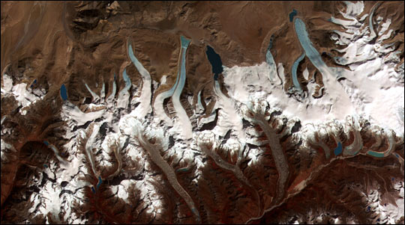
What are the prospects for future sea level rise?
Antarctica: 58 meters sea level equivalent (SLE)
Greenland: 7.4 m
53.3 meters
4.5
Mountain glaciers: 0.4 m
(40 cm)
http://www.antarcticglaciers.org/glaciers-and-climate/what-is-the-global-volume-of-land-ice-and-how-is-it-changing/

Slide 20
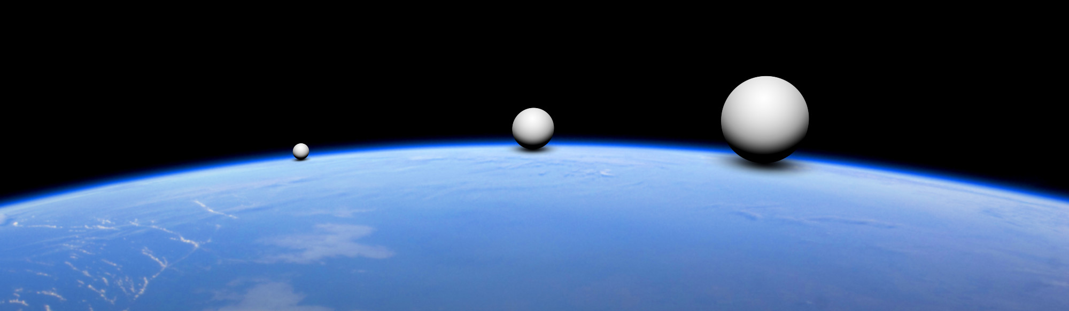
Another way of visualizing these volumes
Mountain glaciers
Greenland
Antarctica
https://glacjoblogia.files.wordpress.com/2018/11/ice_spheres_eng_b.jpg

